Slide 1



Unit 3.1: Fundamentals of Cybersecurity in 5G Networks
Section 3.1.8: PBL - Cybersecurity Risk Analysis in 5G Smart Cities
Part 1: Introduction & Lab Architecture
NeoCity scenario - Connected Traffic Signal System
Notes:
Welcome to Section 3.1.8 of our course, Fundamentals of Cybersecurity in 5G Networks.
In this section, we begin applying the concepts you have learned earlier in Unit 3.1 to a realistic scenario through a Problem-Based Learning activity, also referred to as PBL.
The main purpose of PBL in this course is to place you in the role of security analysts rather than passive learners. Instead of following a predetermined list of actions, you will address a real-world cybersecurity problem where information is incomplete, and results depend on the decisions you make. This reflects how cybersecurity risk analysis is actually carried out in modern 5G deployments, where technology evolves rapidly, multiple stakeholders are involved, and threats are constantly emerging.
The scenario we will investigate is named NeoCity, a smart city deployment that uses 5G connectivity to operate a Connected Traffic Signal System. Roadside units at intersections are equipped with sensors, cameras, and low-latency communications that continuously deliver data over the 5G network to the city traffic management platform. These services are designed to optimize mobility, enhance public safety, and support faster response times in emergencies. However, recent anomalies have been detected in telemetry coming from several roadside nodes. These events have raised concerns about potential security vulnerabilities that need to be examined before the system goes fully live.
Your task during this PBL activity is to apply risk analysis methods to this situation. You will identify and classify assets, model threats, assess likelihood and impact, and propose mitigation measures. You will also validate findings using a dedicated open source laboratory environment that includes a simplified 5G core, a traffic signal control service, monitoring tools, and controlled attack traffic.
The activity is divided into three sessions. In Part 1, we introduce the scenario and ensure that the lab environment is working correctly. In Part 2, you will perform threat modelling and risk assessment. In Part 3, you will communicate results, evaluate residual risk, and reflect on lessons learned. By the end of this activity, you will have strengthened your ability to apply cybersecurity fundamentals to a 5 G-enabled smart city service.

Slide 2
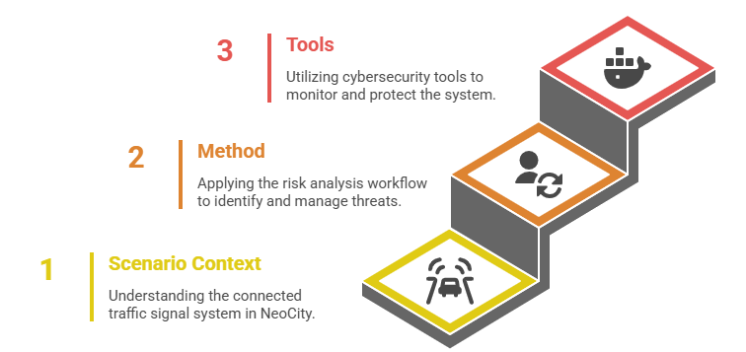

1. Learning Objectives
Understand the NeoCity Connected Traffic Signal System scenario
Explain how PBL will be used to perform cybersecurity risk analysis
Describe the five-step workflow for risk analysis used in this unit
Recognise the key components of the open source 5G lab used in Part 2
Prepare to gather evidence for threat modelling and risk evaluation
Notes:
In this slide, we clarify what you are expected to achieve during Part 1 of this PBL activity. These learning objectives connect the theoretical knowledge acquired earlier in Unit 3.1 with the practical cybersecurity work you will perform in the NeoCity scenario.
The first objective focuses on the scenario context. You will learn how the Connected Traffic Signal System in NeoCity works and why 5G connectivity is critical for its performance. Understanding the system architecture and data flows is essential for identifying assets, attack surfaces, and stakeholders who depend on the service. A clear view of the scenario gives us the foundation to ask the right security questions.
The second objective introduces the method we will use throughout the PBL. Cybersecurity risk analysis is not performed randomly. It follows a structured workflow that begins with defining the scope and continues through threat identification, risk evaluation, mitigation planning, and reporting. You will apply these five steps to the NeoCity case, using observations and evidence from the lab environment to justify your decisions. This reinforces the importance of analytical reasoning and traceability in real cybersecurity work.
The third objective is related to the tools. To support your investigation, you will work with an open-source 5G lab that includes a simplified 5G core, a traffic management application, monitoring dashboards, and a controlled attack environment. These tools will allow you to observe realistic events, detect anomalies, and collect information that feeds into your threat analysis. Becoming familiar with the purpose of each component in the toolchain is important before moving to hands-on activities.
Across these three goals, the central idea is to prepare you to apply what you know. By the end of Part 1, you should have a strong understanding of the real-world problem, a method to analyse it, and a practical toolkit that allows you to investigate risks in a 5 G-enabled smart city service. This preparation positions you to perform meaningful threat modelling and risk assessment in the next part of the activity.

Slide 3
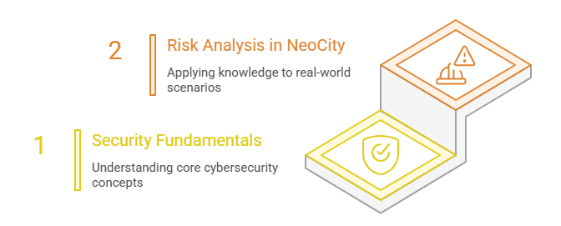
2. From Fundamentals to PBL: Applying 5G Security Knowledge
                We now move from security fundamentals to practical analysis
                Apply CIA, threats, vulnerabilities, and risk concepts to a real 5G system
                Shift from design-time security to operation and evidence-based security
                Your role: analyse, decide, and justify with real lab evidence
Notes:
Here, we explain how we are building a connection between the theoretical knowledge that you studied earlier in Unit 3.1 and the practical work that begins with this PBL activity. Up to now, you have learned the foundations of cybersecurity in 5G networks, including the CIA triad, the classification of threats and vulnerabilities, and the role of identity and access management in enforcing trust. These ideas represent the base of our understanding of what must be protected and why it matters. They are essential components of security fundamentals.
However, cybersecurity is never just an academic exercise. Knowing the theory is only useful when you can apply it to real systems and real situations. This is where our work in NeoCity begins. As shown in the visual, we now move toward risk analysis in NeoCity, which means placing ourselves in a realistic operational environment and making security decisions based on what we observe. The focus shifts to understanding how threats evolve, how attack surfaces appear as the network grows, and how operational evidence gives us insights into actual risk levels.
In this transition, your role changes as well. You are no longer only learning definitions. You are expected to analyse, evaluate, and justify your conclusions using information gathered from the lab environment. Every choice you make should be supported by evidence and a clear understanding of its impact on the system’s confidentiality, integrity, and availability.
This approach reflects real professional practice in 5G cybersecurity. When critical services such as traffic control depend on 5G connectivity, the consequences of security gaps become immediate and tangible. A decision that improves security is only valuable if it can be verified in operation and if it contributes to the resilience of the service.
With this mindset in place, we are ready to introduce the next part of the story. In the next slide, you will learn more about the NeoCity deployment itself, the challenges it faces, and why a thorough security analysis is urgently needed before the system becomes fully operational.

Slide 4
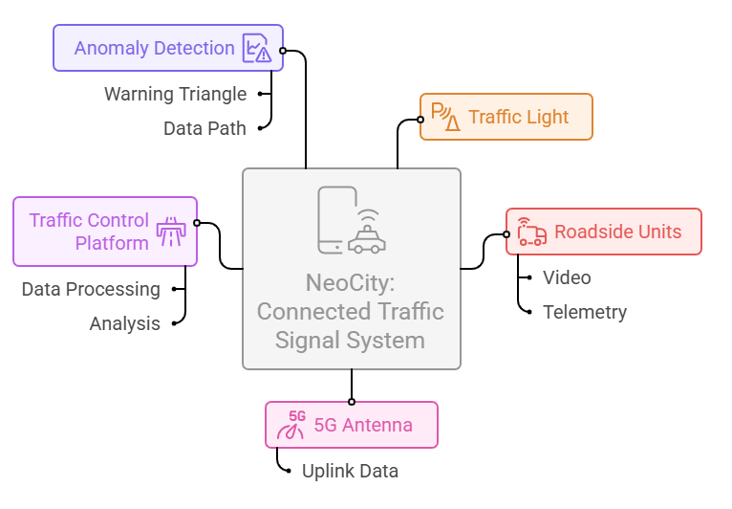
3. NeoCity Scenario: A 5G Connected Traffic Signal System
                Smart intersections rely on 5G connectivity for real-time decisions
                Roadside Units (RSUs) collect video and sensor data from traffic flows
                Anomalies detected in network telemetry raise security concerns
                Service deployment is paused until risk analysis is completed
Notes:
We introduce here the scenario that you will investigate throughout this PBL activity. The system we are working with is called NeoCity: Connected Traffic Signal System. It uses 5G connectivity to help the city manage real-time traffic conditions, improve mobility, and support safer roads for citizens.
At selected intersections across NeoCity, Roadside Units, or RSUs, collect two main types of information. The first type is video data from cameras that track how vehicles and pedestrians move through the junction. The second type is telemetry data from sensors that monitor road conditions and queues. Both data streams are transmitted over the 5G network through a nearby 5G antenna to a central Traffic Control Platform. There, the data is processed to adjust signal timings, detect congestion, and ensure efficient operation.
However, before this system becomes fully operational, the city has detected anomalies in the telemetry data coming from some of the roadside units. These anomalies could be caused by technical faults or by something more concerning. Since 5G-enabled traffic control has real-world consequences, any uncertainty about the integrity or authenticity of this information requires immediate investigation. Even a small disruption in the communication path could lead to unsafe traffic conditions, for example, incorrect light changes or delays in emergency vehicle routes.
Our role in this activity is to examine this situation from a cybersecurity risk perspective. We need to understand the system, the data flows, and the technologies involved so that we can identify what might go wrong and how severe the impact could be. The diagram you see in this slide highlights the critical assets and the data path where the anomalies appear. This will guide our analysis as we move forward.
In the next slide, we will look at the different stakeholders involved in this system. Each group has specific responsibilities and security expectations. Understanding who owns which assets and who is accountable for protecting them is a key first step in any risk analysis.

Slide 5
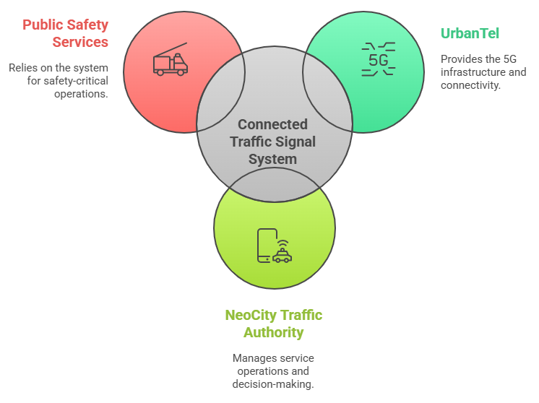
4. Who is Responsible for 5G Security in NeoCity?
                Multiple stakeholders share responsibility for securing operations
                UrbanTel provides and maintains the 5G network infrastructure
                NeoCity Traffic Authority operates the traffic control service and depends on trustworthy data
                Public Safety Services rely on system availability for emergency responses
Notes:
This slide presents the key stakeholders who share responsibility for the security of the Connected Traffic Signal System in NeoCity. Understanding who is involved and what role each actor plays is essential before performing risk analysis, because cybersecurity decisions always have operational and organisational consequences.
The first stakeholder is UrbanTel, the 5G operator. UrbanTel designs, deploys and maintains the 5G connectivity that the traffic system relies on. This means they are responsible for the correct functioning of the radio access network, the 5G core and the related network services that transport video and telemetry to the central platform. Any loss of availability or integrity within their infrastructure can have a direct impact on public services.
The second stakeholder is the NeoCity Traffic Authority. This group operates the traffic control platform and makes decisions that affect the safety and efficiency of citizens. They depend on trusted data to adjust traffic signals, prevent congestion and prioritise emergency vehicles. Their responsibility is to ensure that the system remains operational, that decisions are accurate and that incidents are handled quickly.
The third stakeholder shown is Public Safety Services, including emergency responders such as firefighters, ambulance teams and police units. These organisations rely on timely access to the transport network and therefore depend on the availability and accuracy of traffic signal operations. For them, any cybersecurity failure could translate into higher response times, unsafe routing or even loss of life in critical situations.
These examples illustrate that cybersecurity in NeoCity is not only about protecting data or preventing unauthorised access. It is a shared responsibility that affects public safety, service delivery and critical infrastructure reliability. When analysing risks, we must consider how each stakeholder contributes to security, as well as how they are affected by weaknesses in the system.
In the next slide we will introduce the risk analysis workflow that you will apply in this PBL activity. This workflow will guide how you identify threats, evaluate risks and propose mitigations for this smart city service.

Slide 6
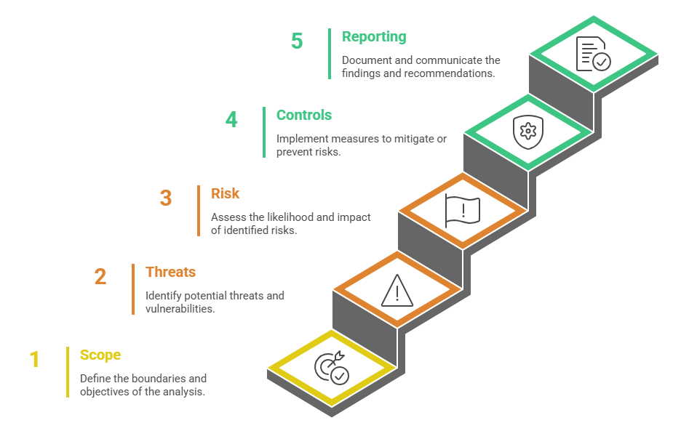
5. Risk Analysis Workflow for NeoCity
                We follow a five-step workflow to analyse cybersecurity risks
                Each step supports evidence-based decision-making
                Results guide mitigations and stakeholder communication
                Same workflow used in the PBL investigation
Notes:
In this slide, we introduce the structured risk analysis workflow that we will use throughout the PBL activity. The process contains five key steps, each designed to support clear and evidence-based reasoning when analysing cybersecurity risks in NeoCity.
The first step is Scope. Before any analysis begins, we need to define the boundaries of what we are assessing and the objectives of this work. For example, are we focusing only on the roadside units, or on the entire traffic control system? A well-defined scope ensures that the investigation remains focused and manageable.
The second step is Threats. Here we identify potential threats and vulnerabilities that could compromise the system. This includes anything that could reduce the confidentiality, integrity, or availability of the traffic signal service. We rely on models, observations, and known attacker behaviors to uncover where weaknesses may exist.
The third step is Risk. In this stage, we evaluate the likelihood and impact of each threat scenario. Not all threats have the same consequences. A low probability attack that creates major disruption may still be high risk. This evaluation helps us prioritize what must be addressed first.
The fourth step is Controls. Once we understand the risk level, we select and propose mitigation measures. These may include technical controls, monitoring improvements, changes in configuration or stronger authentication requirements. The effectiveness of each control must be justified with reasoning and data.
The fifth and final step is reporting. We document the findings and communicate recommendations to the relevant stakeholders. A risk analysis is valuable only if the results guide decisions and help improve security posture in real operations.
You will use this workflow in Part 2 of the PBL when investigating the anomalies in NeoCity. For now, our next step is to understand the toolchain that enables us to gather evidence and validate risks in a realistic environment.

Slide 7
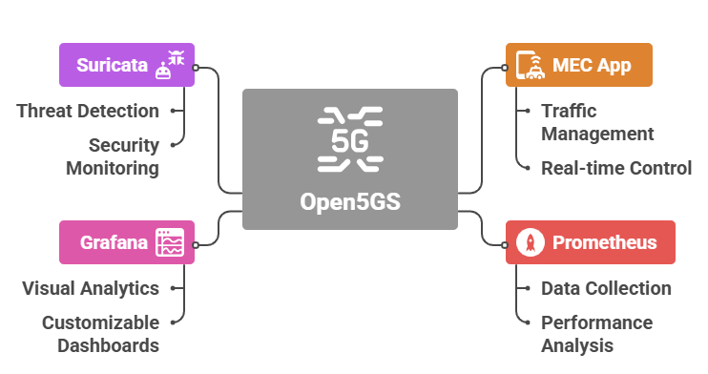
6. Open Source 5G Lab Toolchain
                A lightweight 5G testbed to explore cybersecurity risks in NeoCity
                Includes Open5GS, a MEC service, and live monitoring tools
                Supports attack simulation and evidence collection
                Fully containerized to run on a student laptop
Notes:
A practical investigation of cybersecurity risks requires visibility, control, and trustworthy evidence. For this reason, the NeoCity PBL uses a fully open-source 5G lab toolchain that enables hands-on experimentation in a controlled environment. Each component in this diagram plays a specific role in supporting risk analysis.
At the center of the toolchain, we have Open5GS, which implements a simplified 5G core network. It handles connectivity between roadside units and the traffic management service. Because it is containerized, students can observe and manipulate the network in ways that are not possible in commercial environments. Open5GS is the backbone that allows us to understand how data flows, where trust boundaries exist, and where attacks might cause disruption.
On the right side, we have the MEC App, which represents the traffic control logic. This application consumes video and telemetry to adjust traffic lights in real time. It gives us a clear view of how operational decisions depend on data integrity. When anomalies appear, this part of the system is directly affected, which makes it central to our investigation.
To observe what is happening inside the environment, we rely on Prometheus for data collection and performance analysis. Prometheus extracts metrics that help us monitor how the system behaves during attack simulations or configuration changes. These metrics become part of the evidence we use to justify findings.
Finally, Suricata operates as an intrusion detection system. It monitors network traffic and alerts when suspicious behavior is detected. Suricata helps us connect theory to practice by showing how threats can be identified inside a live 5G environment.
Together, these tools provide the observability, diagnostic insight, and security monitoring necessary for a rigorous analysis of risk. They allow us to validate assumptions, detect vulnerabilities, and evaluate which controls truly improve safety in NeoCity.
Having reviewed the toolchain, we can now focus on how all components interact. The next slide introduces the lab architecture that you will work with during hands-on tasks.

Slide 8
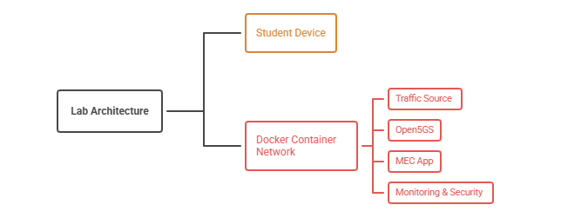
7. Lab Architecture Overview
                All components run as Docker containers on a single machine
                Includes traffic data source, 5G core, MEC app, and monitoring stack
                Network flows mirror NeoCity’s real data path
                Designed for controlled testing and repeatable experiments
Notes:
By now, we understand the tools that make up our 5G cybersecurity testbed. The next step is to see how everything fits together in the lab architecture. All components run inside a Docker Container Network on a single student device, making the environment portable, reproducible and safe for experimentation.
Running everything locally gives us full visibility and avoids the complexity of real operator networks. This setup creates a closed sandbox where we can observe every packet, service and interaction without affecting external systems. It also means that students can restart, modify or break parts of the system without permanent consequences, which is essential to learning by doing.
Inside the container network, the Traffic Source simulates sensor data such as telemetry from roadside units. This is the type of information NeoCity relies on to operate traffic lights and manage real time traffic flow. Simulating data allows us to introduce anomalies and malicious behavior under controlled conditions.
The simulated data flows through Open5GS, which acts as the 5G core. Here we focus on how registration, authentication and session management functions support communication between services. This helps us identify trust boundaries and understand where attackers might target the system.
The MEC App receives the data and performs traffic control logic, similar to how smart city services work in real deployments. Any loss of data integrity here directly affects operational decision making, which allows us to connect cybersecurity risks to real world impact.
Finally, the Monitoring and Security services collect metrics and inspect traffic. They provide evidence for risk evaluation, incident detection and reporting.
Seeing the architecture as a whole prepares us for the hands on phase. Up next, we will launch the lab environment and validate that all components are running correctly before beginning the risk analysis workflow.

Slide 9
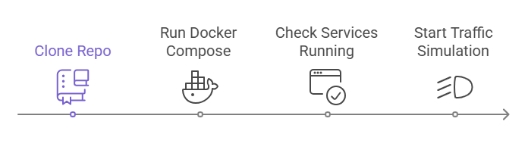
8. Quickstart: Launching the Lab
                Clone the repository and deploy the Docker lab environment
                Verify Open5GS, MEC app, Suricata, and Prometheus are running
                Confirm traffic data flows end-to-end
                Ready to begin risk analysis activities
Notes:
Getting the lab running is the first hands-on activity in this PBL. Once the environment is deployed, we can begin collecting evidence and exploring risks in a realistic 5G scenario. The steps shown here outline the entire quickstart workflow, making it simple for anyone to set up the NeoCity lab without deep infrastructure knowledge.
The process begins by cloning the repository that contains all components of the lab. This ensures everyone works with the same codebase and configuration files. It also allows updates to be distributed quickly to all students if improvements or fixes are needed.
Next, we launch the containerized environment using Docker Compose. This action automatically starts the 5G core (Open5GS), the MEC traffic control application, as well as the monitoring and security stack. The goal is to provide an operational system with minimal effort, letting students focus on analysis rather than installation issues.
Once the environment is running, it is important to verify service availability. This can be done by checking logs, confirming that ports are open, or inspecting dashboards. Ensuring that each service is alive and communicating prevents confusion later when evaluating abnormal behavior or detecting attacks.
The final step is to start the traffic simulation. This simulation acts as the data source that feeds the traffic control logic. With data flowing through all components, we can now observe how the system behaves in normal conditions before introducing changes or threats.
When these four actions are completed, the student is fully equipped to begin risk analysis activities. They will be able to investigate anomalies, validate detection tools, and evaluate the impact of compromised data inside a controlled smart city test environment.
The next slides will guide the students through these hands-on tasks step by step, connecting each part of the analysis workflow with practical evidence from the lab.

Slide 10
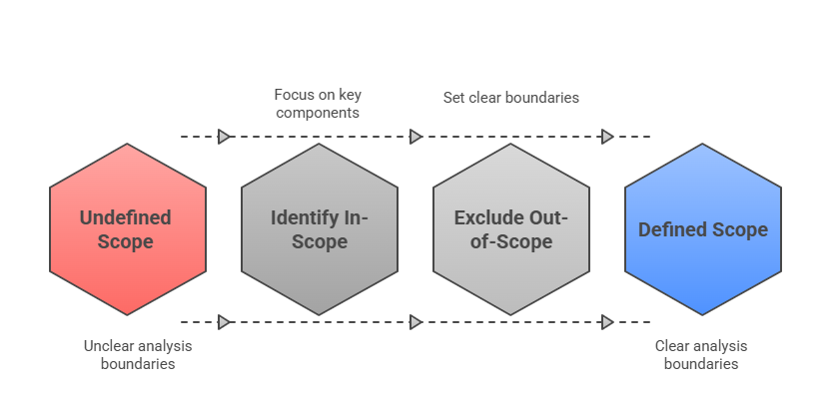
9. Step 1: Define the Scope
                Identify what is included and what is excluded in the analysis
                Focus on the Connected Traffic Signal System and its data flow
                Prioritize anomaly affecting roadside telemetry
                Establish assumptions and operational boundaries
Notes:
Setting the scope is the foundation of any cybersecurity risk analysis. Without clear boundaries, it becomes difficult to decide which systems to evaluate, which data to collect, and which vulnerabilities truly matter. That is why we begin by defining exactly what is included and excluded from our investigation.
In the case of NeoCity, we are focusing on the Connected Traffic Signal System. This includes the telemetry that travels from roadside devices, the 5G connectivity provided by the core network, and the traffic control logic executed in the MEC application. These are the elements directly involved in the anomaly that triggered the investigation. By narrowing the scope to the systems that process operational data, we can work efficiently and avoid distractions.
Equally important is identifying what is out of scope. For example, citizen smartphones, internet content services, or unrelated municipal systems may interact with NeoCity’s architecture, but they are not relevant to the specific risk being assessed. Declaring these elements out of scope prevents confusion later when threats are considered. It keeps the analysis aligned with evidence and operational relevance.
Defining the scope also helps formalize assumptions. For instance, we assume that the network infrastructure outside the core behaves normally and that legitimate users are authorized correctly. If these assumptions change during the investigation, the scope can be adjusted, but at least we begin from a structured baseline.
A clear scope improves communication with stakeholders. When presenting risk findings, decision makers need to understand what the conclusions apply to and what remains unknown. Precision avoids overestimating or underestimating the severity of issues.
Now that we understand the boundaries of the problem, we can focus on what could go wrong inside that defined space. The next step in the workflow is to identify threats that might compromise the security or performance of the scoped system.

Slide 11
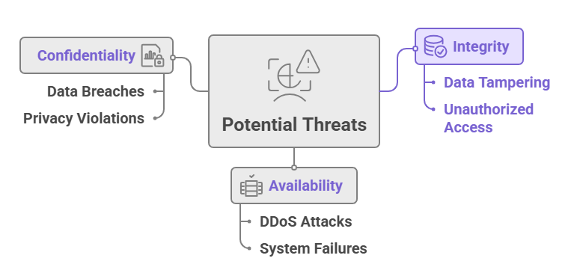
10. Step 2: Identify Threats
                Determine what could go wrong in the scoped system
                Focus on the telemetry anomaly as a potential attack vector
                Consider threats to availability, integrity, and confidentiality
                Document attacker capabilities, motivation, and entry points
Notes:
Once we have a clear scope, the next task is to identify what could threaten the system we are analyzing. A threat can be any circumstance, capability or event that has the potential to compromise the Confidentiality, Integrity or Availability of the service. These three principles represent the core goals of cybersecurity protection, and understanding how a threat can impact each one helps us determine the severity of the risk.
Starting with Confidentiality, we focus on whether sensitive information could be exposed or accessed by unauthorized actors. In the NeoCity context, telemetry data from roadside units might reveal traffic patterns or vehicle behavior if intercepted. This could lead to data breaches or privacy violations, especially when combined with other city data sources.
Integrity refers to the trustworthiness of the information flowing through the system. If an attacker tampers with telemetry data, falsifies alerts or injects fake traffic conditions, the MEC application could make harmful decisions. A manipulated signal timing plan could increase congestion or create dangerous situations for pedestrians and vehicles. Preserving integrity is therefore essential for safe real-world operation.
The third category is Availability, which measures whether the system continues functioning when required. A targeted DDoS attack against the 5G core or a failure in the monitoring system could delay or interrupt data delivery. Even temporary service disruption can create cascading effects in a safety critical environment like traffic coordination.
Threat identification does not require confirming that an attack is already happening. Instead, we explore what an attacker with certain motives and capabilities might try to do. This structured anticipation is key to proactive risk reduction.
With a better understanding of how threats could undermine the objectives of the NeoCity traffic system, we are ready to assess their significance. The next step of the workflow is to analyze likelihood and impact so we can prioritize which risks demand the most attention.

Slide 12
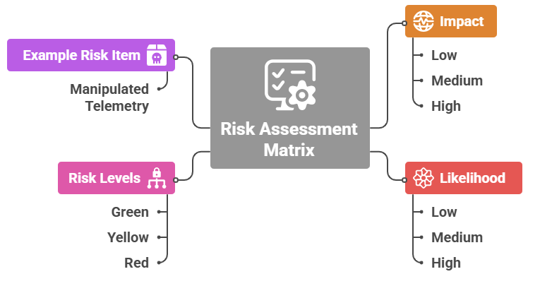
11. Step 3: Assess the Risk
                Evaluate the likelihood and impact of each threat scenario
                Use a risk matrix to prioritize what matters most
                Focus on threats that can cause unsafe traffic behavior
                Risk levels guide mitigation planning
Notes:
Evaluating the risk of each identified threat helps us understand which scenarios deserve the most attention. Not every vulnerability or possible attack represents the same danger. Some issues may be inconvenient but not harmful, while others could put lives at risk. The risk assessment process allows us to compare threats using two dimensions: likelihood and impact.
Likelihood represents how probable it is that a threat will occur. In the NeoCity case, we consider factors such as attacker capability, access to roadside devices and exposure of the communication path. A threat with a high chance of being executed should be prioritized, especially if exploitation does not require sophisticated tools.
Impact measures the potential harm if the threat materializes. In a smart traffic system, operational impact translates directly into safety, mobility and public trust. For example, if telemetry is manipulated and traffic lights behave incorrectly, the consequences could include collisions, blocked emergency vehicles or panic among road users.
By combining likelihood and impact in a risk matrix, we assign a risk level: typically Green for low, Yellow for medium and Red for high risk situations. Red items require urgent attention, because their consequences are unacceptable. In our example, manipulated telemetry often results in high impact, since incorrect data drives unsafe operational decisions.
This structured method prevents assumptions and personal judgement from controlling security priorities. Instead, decisions are guided by evidence: how strong the threat is and how severe the consequences would be.
Risk assessment also supports communication among stakeholders. It enables operators, engineers and safety teams to understand why certain vulnerabilities must be treated immediately while others can be handled later. A clear risk level ensures a clear message.
Once the highest risks are identified, the next step is to take action. We now move to Step 4, where we propose and evaluate controls that can reduce the likelihood or impact of the most critical threats.

Slide 13
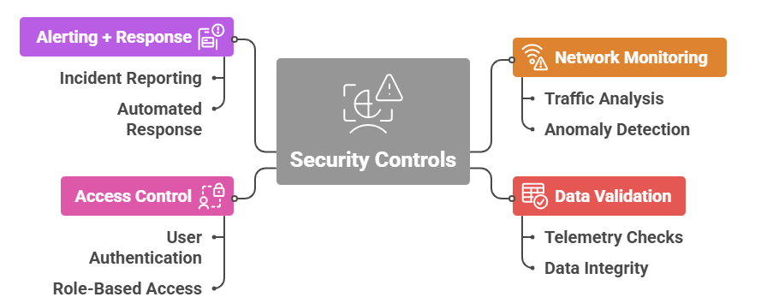
12. Step 4: Apply Security Controls
                Select controls that reduce the likelihood or impact of threats
                Strengthen data integrity and system resilience
                Monitor effectiveness through telemetry and alerts
                Validate improvements with attack simulation
Notes:
After risks have been identified and assessed, the next objective is to reduce both the likelihood and the impact of those risks. This is achieved through the implementation of security controls. In the NeoCity traffic signal system, controls work together to protect the confidentiality, integrity, and availability of operational data and services.
The first category is Network Monitoring. A 5G environment is dynamic, with devices connecting and transmitting data continuously. Monitoring network traffic allows detection of patterns that indicate malicious activity, including anomaly detection, command and control behaviors, or early signs of DDoS attacks. Tools like Suricata generate alerts when deviations from normal behavior suggest a potential intrusion, enabling quick investigation.
The second category is Data Validation. Traffic signal decisions rely on telemetry from roadside units and other sensors. If an attacker manipulates these data streams, the system may make unsafe operational decisions. Validation mechanisms ensure data integrity by verifying authenticity, filtering corrupted input, and applying consistency checks before data influence actuation or analytics.
A third control area is Access Control. Critical services must only be accessed by authenticated and authorized users. Techniques such as user authentication and role-based access reduce opportunities for unauthorized configuration changes or lateral movement inside the operational environment. Limiting privileges directly lowers the probability of successful exploitation.
Finally, Alerting and Response mechanisms support operations teams by generating incident notifications and enabling automated containment actions when threats are detected. Timely response is essential to minimizing service disruption, particularly in systems with safety-critical implications like urban traffic management.
Together, these controls form a layered defense strategy. Each one addresses different attack vectors while contributing to a stronger security posture. Controls must also remain effective over time, meaning they require ongoing verification, performance monitoring, and iterative refinement. With these protections in place, the risk landscape becomes manageable and measurable, preparing the system for the final step of the workflow, which focuses on reporting and continuous improvement.

Slide 14
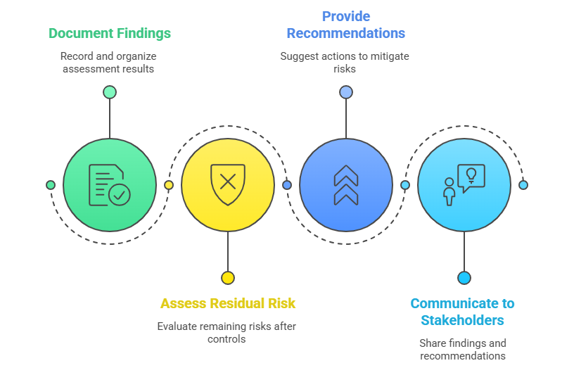
13. Step 5: Reporting
                Document assessment results and applied controls
                Explain residual risk after mitigation
                Share recommendations for improvement
                Communicate findings to decision makers
Notes:
The final stage of the analysis process focuses on reporting. At this point, all the work completed throughout the assessment comes together in a structured output that informs future security decisions. The reporting activities on the slide highlight four key responsibilities.
First, the team must document findings. This involves organizing all relevant information: the system components within scope, the identified threats, the results of the risk assessment, and the security controls that have been applied. Clear documentation ensures traceability, helps justify decisions, and allows the assessment to be repeated or updated later.
Next, we assess residual risk. Even after mitigation efforts, some level of risk remains. This may be due to technical limitations, cost constraints, or because further actions are planned but not yet implemented. By describing what risks are still present and assigning them a risk level, stakeholders can prioritize future improvements. Understanding residual risk also supports accountability. It demonstrates that the team has recognized ongoing exposure rather than assuming everything is now safe.
The third task is to provide recommendations. Strong reporting not only states what was found but also proposes what should happen next. Recommendations may include adding new controls, improving monitoring rules, adjusting access policies, or scheduling periodic security reviews. These suggestions transform the report into an action plan for continuous improvement.
Finally, the results must be communicated to stakeholders. Different audiences require different levels of detail. Technical teams need specific evidence to validate and maintain protections. Operational managers need clear summaries to support service continuity. Public authorities and compliance auditors need assurance that the system is addressing safety and privacy requirements. Effective communication strengthens trust and motivates timely decision-making.
Reporting, therefore, closes the loop between operational insights and design-time security. The knowledge gained here will influence future architectures, enabling NeoCity to evolve securely as new features and services are deployed. By documenting, evaluating, recommending, and communicating, the city ensures that cybersecurity remains an ongoing, proactive responsibility.

Slide 15
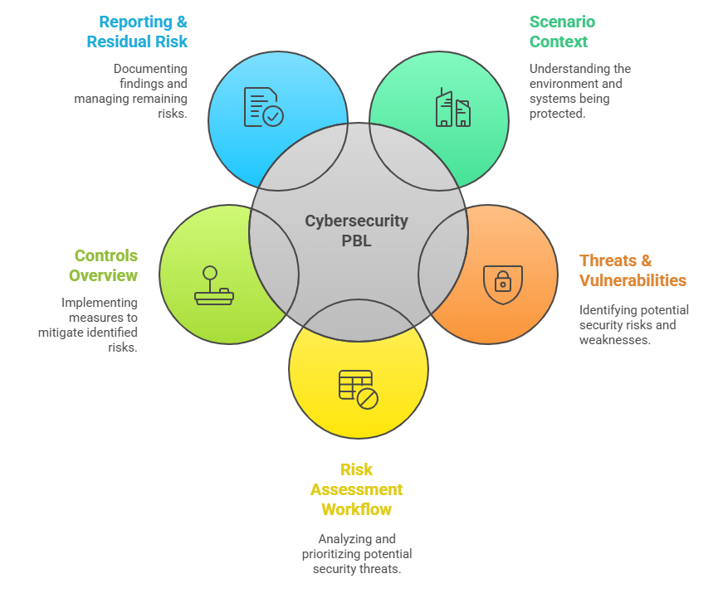
14. Summary of Part1 (What We Have Learned)
                Defined the scenario context: NeoCity and its connected traffic-signal architecture
                Identified key stakeholders and assets
                Mapped potential threats affecting confidentiality, integrity, and availability
                Applied a structured risk analysis workflow
                Reviewed security controls used in the lab (monitoring, validation, access control)
                Documented results to support continuous improvement
Notes:
The first part of the PBL helped establish the foundation that is needed before any meaningful cybersecurity assessment can take place. We began by exploring the Scenario Context, gaining a clear understanding of how NeoCity uses 5G connectivity to enable smart traffic signal control. Recognizing the architecture, data flows, and operational requirements gave us visibility into what needs to be protected and why security matters for both safety and efficiency.
Next, we examined Threats and Vulnerabilities. By mapping risks to the principles of Confidentiality, Integrity, and Availability, we identified what could go wrong if security controls fail. Examples included unauthorized access, manipulated telemetry, or service outages that could directly disrupt urban mobility and emergency response.
With threats identified, we introduced the Risk Assessment Workflow. This structured method supports decision-making by analyzing the likelihood of each threat and its potential impact. We explored how a risk matrix helps categorize risks into different priority levels so that effort is focused where it truly provides value. This approach ensures that limited resources are used efficiently to protect the most critical components.
We then looked at Security Controls that can reduce risk in practice. Monitoring systems like Suricata and Prometheus detect anomalies and collect operational evidence. Access control limits who or what can communicate with system components. Data validation protects against manipulation at the application layer. These controls reflect the shift from secure by design to secure by operation.
Finally, we covered Reporting and Residual Risk. Clear documentation and communication make the analysis useful to decision makers. Even after applying controls, some risk remains, and it must be made visible so stakeholders can plan further improvements and maintain accountability.
By bringing these elements together, we built a complete picture of how cybersecurity should be analyzed in a modern 5G-enabled smart city. In the next part of the activity, students will use these methods hands on, applying them to real operational data in the NeoCity environment.

